Slide 1

S3 Bucket
S3: Simple Storage Service

Slide 2

Contents :
What is S3 ?
Key Features of S3
Use cases
S3 storage classes
How to create bucket and stores data
Versioning

Slide 3
Uploading and downloading files
Bucket policies
IAM roles and policies
S3 block public Access
S3 lifecycle policies
Static Website Hosting with S3
S3 replication (cross region and same region replication )

Slide 4
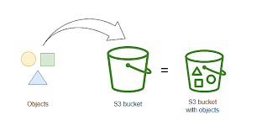
What is S3 ?
S3 stands for simple storage service
Cloud based object storage service from AWS
Used to store and retrieve any amount of data from anywhere on the web.
Designed for 99.99999999%(11 9’s) durability.

Slide 5
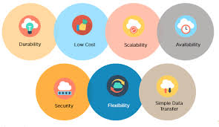
Key features of Amazon S3
Scalable
Secure
Durable
Accessible
Cost-effective

Slide 6
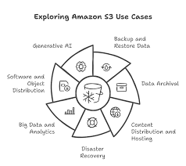
Common Use cases
Backup & Restore
Static Website Hosting
Data Archiving
Big Data Analytics
Media Hosting
Software Delivery

Slide 7
S3 storage classes
Class | Access Frequency | Retrieval Time | Cost | Use Case
Standard | Frequent | Milliseconds | $$$ | Active data
Standard-IA | Infrequent | Milliseconds | $$ | Backup, DR
One Zone-IA | Infrequent (1 AZ) | Milliseconds | $ | Non-critical, cheaper
Intelligent-Tiering | Variable | Milliseconds | $$ - $$$ | Unknown access patterns
Glacier | Rare/Archive | Minutes-Hours | $ | Archived data
Glacier Deep Archive | Very Rare/Compliance | ~12 Hours | Lowest $$ | Long-term archive

Slide 8
How to create bucket and stores the data
Step 1 : Go to the AWS console https://aws.amazon.com/console/
Step 2 : Navigate to s3 from AWS services
click create bucket
Enter :
Bucket name : must be globally unique
Region : where data will be stored
Configure options (versioning , logging )
Set permissions (e.g, block public access)
click “ create bucket “

Slide 9
Step 3 : upload data
1. open the created bucket
2. Click “upload”
3. Drag & Drop files or browse your system
4. configure:
storage class (e.g , standard IA ,Glacier)

Slide 10
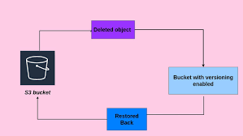
Versioning :
It allows to keep multiple versions of an object in a bucket
Protect against accidental overwrites and deletions
Various S3 versioning:
Enable versioning
Object versions
Delete markers
Suspending versioning

Slide 11
Uploading and downloading files in amazon s3
Using Aws console :
open Aws S3 console
select or create a bucket
click “upload”
Add files/folders
set permissions (e.g. public , private)
click “upload”

Slide 12

Downloading files from S3
Using AWS console
Go to the S3 bucket
Click on the file
Click “download”

Slide 13
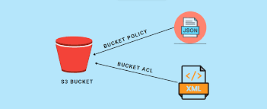
S3 bucket policies
S3 bucket policy is a resource –based policy attached directly to an S3 bucket
It controls permissions to object
Written in json format
Supports fine-grained control (actions , resources )

Slide 14
Public read only access example:
{
"Version": "2012-10-17",
"Statement": [
{
"Sid": "PublicReadGetObject",
"Effect": "Allow",
"Principal": "*",
"Action": "s3:GetObject",
"Resource": "arn:aws:s3:::your-bucket-name/*"
}
]
}

Slide 15
Read only access for specific IAM user
{
"Version": "2012-10-17",
"Statement": [
{
"Sid": "AllowSpecificUserReadOnly",
"Effect": "Allow",
"Principal": {
"AWS": "arn:aws:iam::ACCOUNT-ID:user/USERNAME"
},
"Action": [
"s3:GetObject",
"s3:ListBucket"
],
"Resource": [
"arn:aws:s3:::your-bucket-name",
"arn:aws:s3:::your-bucket-name/*"
]
}
]
}

Slide 16
Temporarily public Access
{
"Version": "2012-10-17",
"Statement": [
{
"Sid": "TemporaryPublicAccess",
"Effect": "Allow",
"Principal": "*",
"Action": "s3:GetObject",
"Resource": "arn:aws:s3:::your-bucket-name/*",
"Condition": {
"DateLessThan": {
"aws:CurrentTime": "2025-05-20T00:00:00Z"
}
}
}
]
}

Slide 17
IAM roles and policies
IAM controls who can access AWS resources and what actions they perform
IAM policies
json documents that defines permissions
Attached to users , groups , roles
Types :
user policy , Group policy , Role policy , managed policy

Slide 18
Full access of a bucket
{
"Version": "2012-10-17",
"Statement": [
{
"Effect": "Allow",
"Action": "s3:*",
"Resource": [
"arn:aws:s3:::my-bucket",
"arn:aws:s3:::my-bucket/*"
]
}
]
}

Slide 19
IAM roles:
An AWS identity with specific permissions
Assumed by users, services or applications
Example :
Role for EC2 to Access S3
1.Create a role with an S3 access policy
2. Attach it to the instance
3 . The instance can access S3 using its instance profile

Slide 20
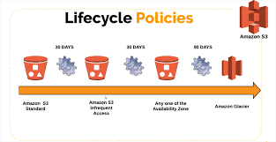
S3 Life Cycle Policies :
Automated rules that manage the storageclass and expiration of S3 objects
Helps to optimize cost and data retention
Life cycle policy actions
Transition
Expiration
Abort incomplete uploads
Delete old versions

Slide 21
Static website hosting with S3
A static website is made up of fixed content: HTML, CSS, JS, images, and files. There's no backend code (PHP, Python, etc.) or database.
Step1 : Create S3 bucket
Step2: upload website files
Step3: Enable static website hosting

Slide 22
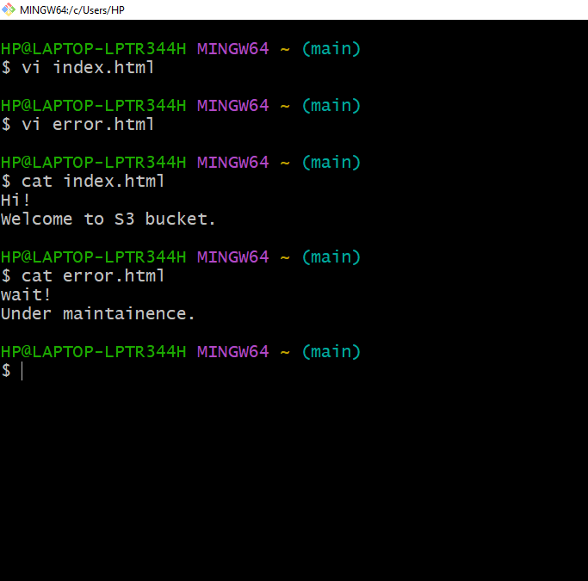
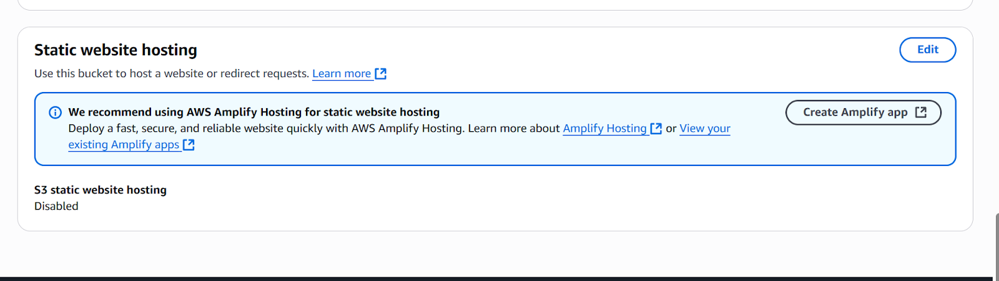
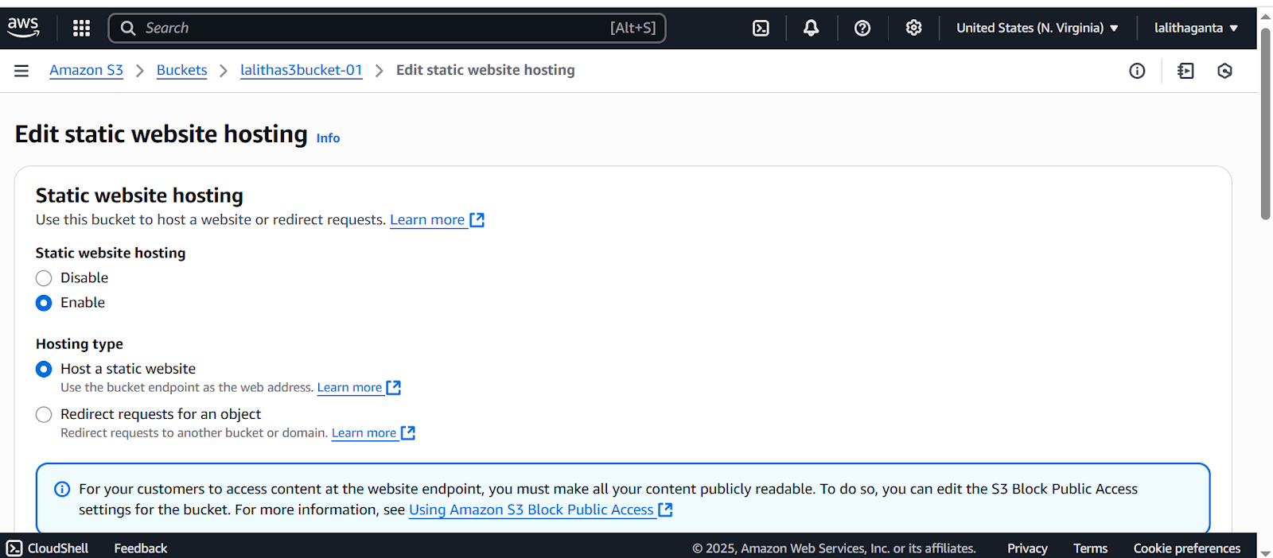

Slide 23
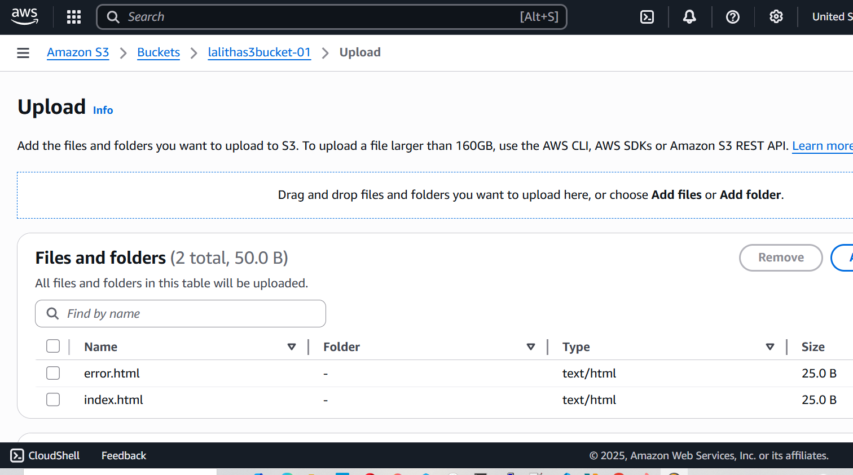
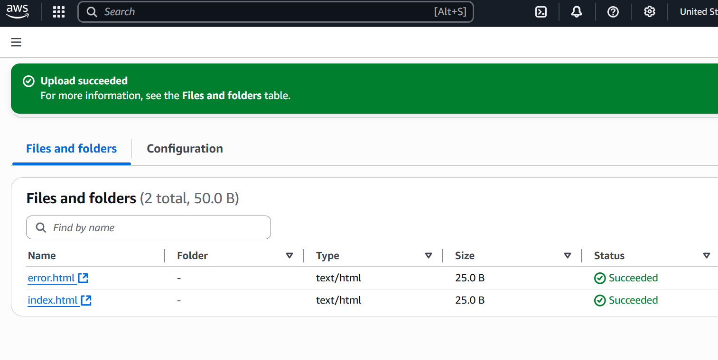

Slide 24
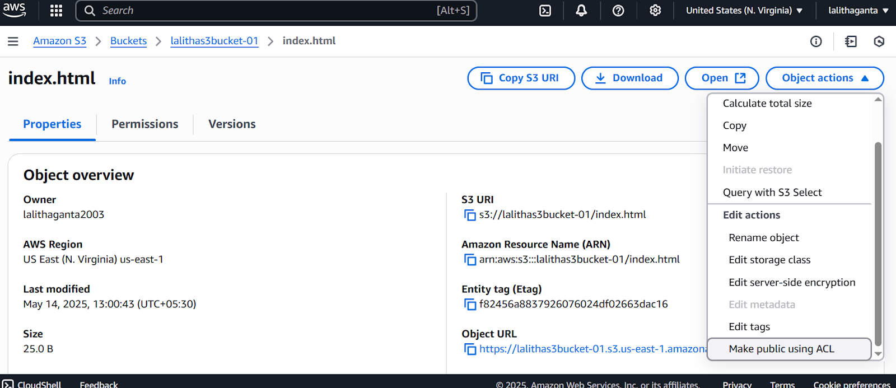
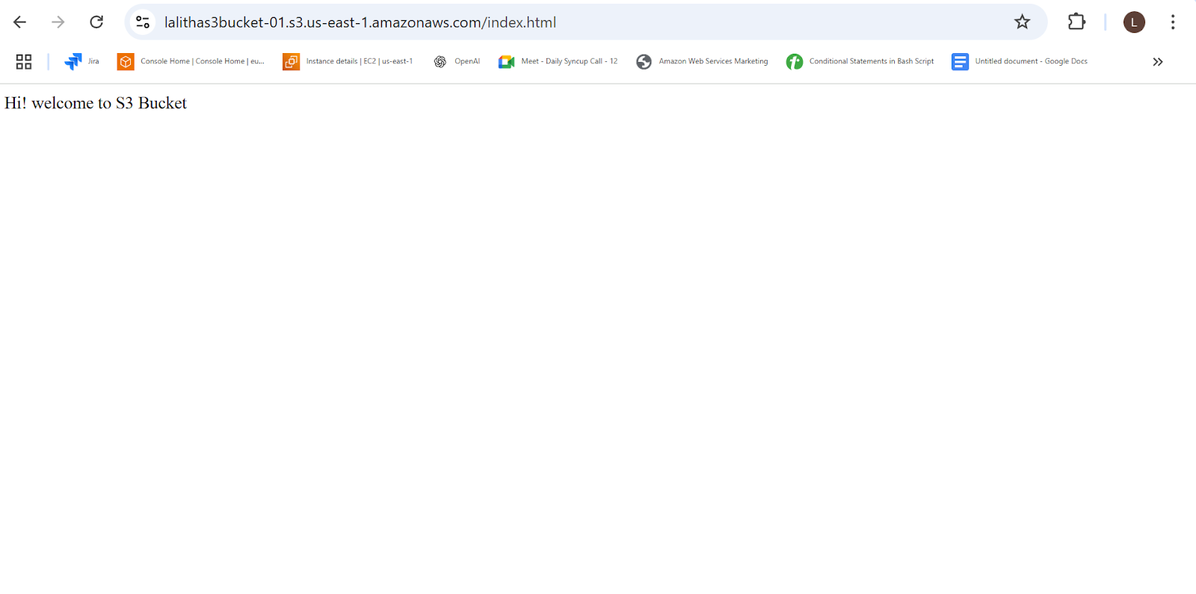

Slide 25
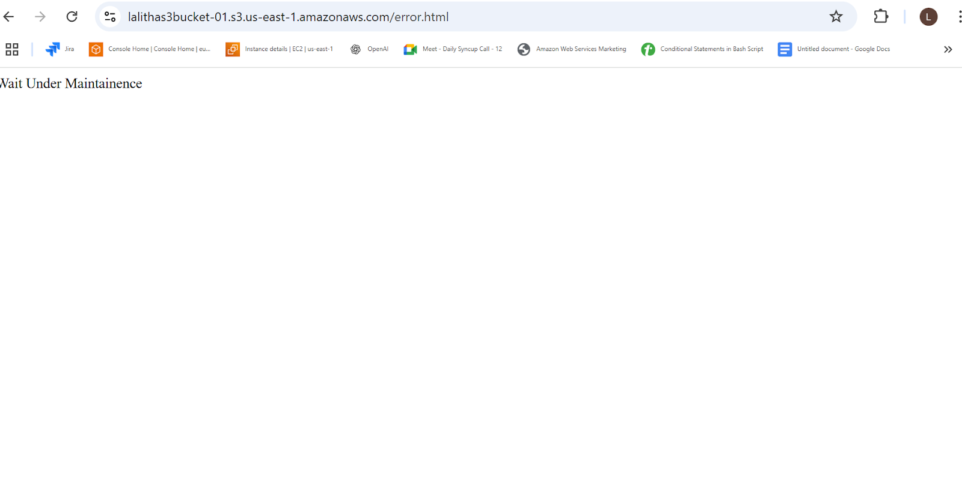

Slide 26
The below code is used to read the file which are uploaded in the bucket
{
"Version": "2012-10-17",
"Statement": [
{
"Sid": "PublicReadGetObject",
"Effect": "Allow",
"Principal": "*",
"Action": "s3:GetObject",
"Resource": "arn:aws:s3:::example.com/*"
}
]
}

Slide 27
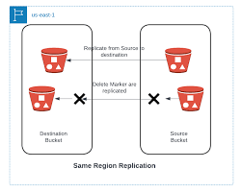
S3 Replication:
S3 Replication is an Amazon S3 feature that automatically copies objects across buckets (same or different AWS regions). It supports:
Cross-Region Replication (CRR)
Same-Region Replication (SRR)

Slide 28
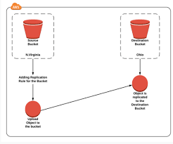
Cross-Region Replication (CRR)
Source & destination buckets are in different AWS regions
Used for geo-redundancy and compliance
Same-Region Replication (SRR)
Buckets in the same AWS region
Used for logging, backup, staging, etc.

Slide 29


